Slide 1

Flight Delay Prediction
Abdulmajeed Alharbi

Slide 2



Goal The goal of this project is to use the 'DecisionTreeClassifier' model from sklearn library to predict the flight delay in January month for US flights, and to know what destination or aircraft that causes more delays

Slide 3

Data
Dataset contains 583986 flights information for January 2019 and 607030 flights for January 2020, with 20 features for each, 16 are categorical. And 4 features are numrical like departure time, arrival time, departure time block and distance. Other features could be grouped into one category, for example 'Carrier code' and 'Airline ID. ** data included in the data folder as CSV file.

Slide 4

Tools Numpy and Pandas for data manipulation Scikit-learn for modeling pandas profiling and Seaborn for plotting

Slide 5
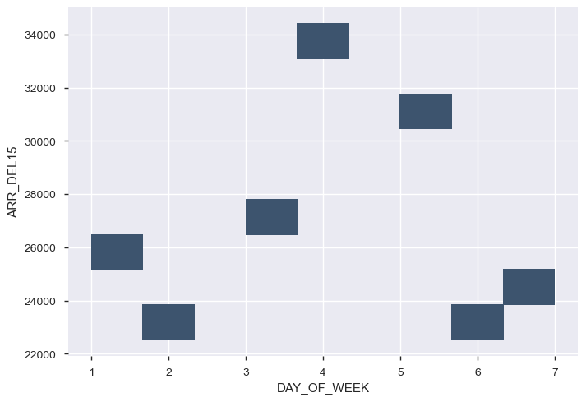
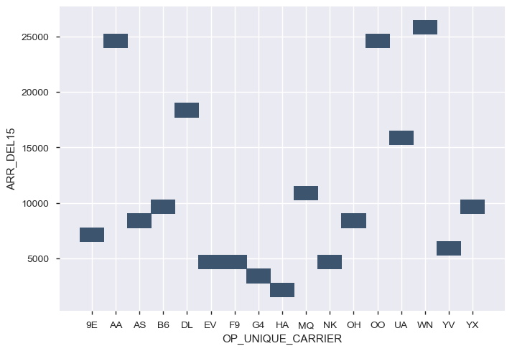
Findings
The features that may affect the delay:
Day of week , Airline carrier , Aircraft , Origin , Destination , Departure time

Slide 6
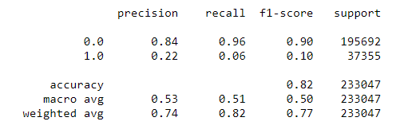
DecisionTreeClassifier Model

Slide 7


What next ?

Slide 8
Thank you

